Slide 1
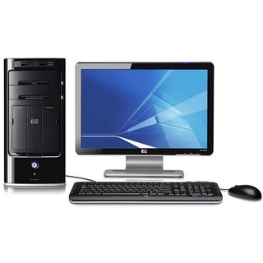
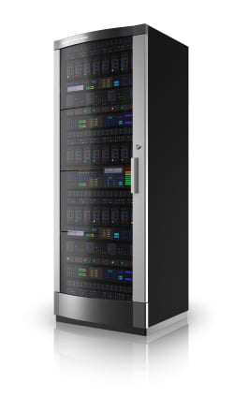

What are Web Services? Architecture, Types, Example
Web service is a standardized medium to propagate communication between the client and server applications on the World Wide Web. A web service is a software module that is designed to perform a certain set of tasks.
The web services can be searched for over the network and can also be invoked accordingly. When invoked, the web service would be able to provide the functionality to the client, which invokes that web service.
Server
Client
Request from Client to the Server
Response from Server to the Client

Slide 2
What are Web Services? Architecture, Types, Example
The below diagram shows a very simplistic view of how a web service would actually work. The client would invoke a series of web service calls via requests to a server which would host the actual web service.
These requests are made through what is known as remote procedure calls. Remote Procedure Calls(RPC) are calls made to methods which are hosted by the relevant web service.
Server
Host the Web Service
Client
Request from Client to the Server
Response from Server to the Client

Slide 3
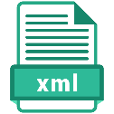
What are Web Services? Architecture, Types, Example
As an example, Amazon provides a web service that provides prices for products sold online via amazon.com. The front end or presentation layer can be in .Net or Java but either programming language would have the ability to communicate with the web service.
The main component of a web service is the data which is transferred between the client and the server, and that is XML. XML (Extensible markup language) is a counterpart to HTML and easy to understand the intermediate language that is understood by many programming languages.
So when applications talk to each other, they actually talk in XML. This provides a common platform for application developed in various programming languages to talk to each other.
Web services use something known as SOAP (Simple Object Access Protocol) for sending the XML data between applications. The data is sent over normal HTTP. The data which is sent from the web service to the application is called a SOAP message. The SOAP message is nothing but an XML document. Since the document is written in XML, the client application calling the web service can be written in any programming language.
Server
Host the Web Service
Client
Request from Client to the Server
Response from Server to the Client

Slide 4
What are Web Services? Architecture, Types, Example
Why do you need a Web Service?
Modern day business applications use variety of programming platforms to develop web-based applications. Some applications may be developed in Java, others in .Net, while some other in Angular JS, Node.js, etc.
Most often than not, these heterogeneous applications need some sort of communication to happen between them. Since they are built using different development languages, it becomes really difficult to ensure accurate communication between applications.
Here is where web services come in. Web services provide a common platform that allows multiple applications built on various programming languages to have the ability to communicate with each other.
Web Services
SOAP web services
RESTful web services

Slide 5
What are Web Services? Architecture, Types, Example
Web Services Advantages
Exposing Business Functionality on the network - A web service is a unit of managed code that provides some sort of functionality to client applications or end users. This functionality can be invoked over the HTTP protocol which means that it can also be invoked over the internet. Nowadays all applications are on the internet which makes the purpose of Web services more useful. That means the web service can be anywhere on the internet and provide the necessary functionality as required.
Interoperability amongst applications - Web services allow various applications to talk to each other and share data and services among themselves. All types of applications can talk to each other. So instead of writing specific code which can only be understood by specific applications, you can now write generic code that can be understood by all applications.
A Standardized Protocol which everybody understands - Web services use standardized industry protocol for the communication. All the four layers (Service Transport, XML Messaging, Service Description, and Service Discovery layers) uses well-defined protocols in the web services protocol stack.
Reduction in cost of communication - Web services use SOAP over HTTP protocol, so you can use your existing low-cost internet for implementing web services.

Slide 6
What are Web Services? Architecture, Types, Example
Web service Characteristics
They are XML-Based - Web Services uses XML to represent the data at the representation and data transportation layers. Using XML eliminates any networking, operating system, or platform sort of dependency since XML is the common language understood by all.
Loosely Coupled – Loosely coupled means that the client and the web service are not bound to each other, which means that even if the web service changes over time, it should not change the way the client calls the web service. Adopting a loosely coupled architecture tends to make software systems more manageable and allows simpler integration between different systems.
Synchronous or Asynchronous functionality- Synchronicity refers to the binding of the client to the execution of the service. In synchronous operations, the client will actually wait for the web service to complete an operation. An example of this is probably a scenario wherein a database read and write operation are being performed. If data is read from one database and subsequently written to another, then the operations have to be done in a sequential manner. Asynchronous operations allow a client to invoke a service and then execute other functions in parallel. This is one of the common and probably the most preferred techniques for ensuring that other services are not stopped when a particular operation is being carried out.
Ability to support Remote Procedure Calls (RPCs) - Web services enable clients to invoke procedures, functions, and methods on remote objects using an XML-based protocol. Remote procedures expose input and output parameters that a web service must support.
Supports Document Exchange - One of the key benefits of XML is its generic way of representing not only data but also complex documents. These documents can be as simple as representing a current address, or they can be as complex as representing an entire book.

